Slide 1
Course Introduction & Statistical Rethinking
MAR 536 Biological Statistics II
January 17 2023
Instructor: Gavin Fay
Teaching Assistant: Lucy McGinnis

Slide 2
Overview Lecture
Course Description (syllabus)
Objectives
Introductions, Community Guidelines
Course Description (syllabus)
Course Text
Evaluation Procedures
Schedule
Chapter 2. Data Management & Software
Statistical Rethinking
Overview of Methods

Slide 3
Course Description
Student-led learning in statistical analysis of ecological data.
Guided learning in advanced statistical analysis, as applied to ecological research and other fields of marine science.
Advanced concepts in probability, hypothesis testing, and estimation will be presented by students, including analyses of example data sets and problems.
Students will be required to learn selected methods, present topics to the class that are relevant to their graduate research, and complete a class project.
A computer lab, focused on introductory and intermediate programming and analysis using R.

Slide 4
Course Objectives
Self-learning in advanced quantitative concepts and methods
Familiarity with advanced statistical methods
Experience communicating advanced quantitative topics
Experience in statistical programming

Slide 5
Introductions
Who you are
Preferred name in this class
Your pronouns
Background, Statistics Experience
What do you hope to get out of this class?
A boring fact about you

Slide 6
Community Guidelines
Co-create our expectations for our interactions this semester
University policies & regulations apply
Fay lab & SMAST code of conduct

Slide 7
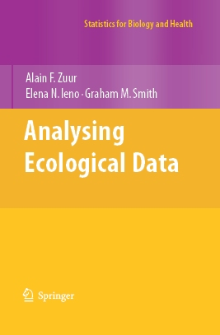
Text
Zuur, A.F., Ieno, E.N. and Smith, G.M. (2007). Analysing Ecological Data. Springer. 700p. Series: Statistics for Biology and Health.
Two parts:
Statistical theory (Chap’s 1-19)
Case studies (Chap’s 20-37)

Slide 8
Aim of the book (and the class): Introduce advanced techniques to statistically literate biological/ecological scientists. Presentations are ‘ecologist friendly.’
The required background for this book (and this class) is familiarity with basic statistics:
Normal distribution
p-values
Correlation
Regression
Hypothesis testing
Independent statistical programming and debugging.

Slide 9
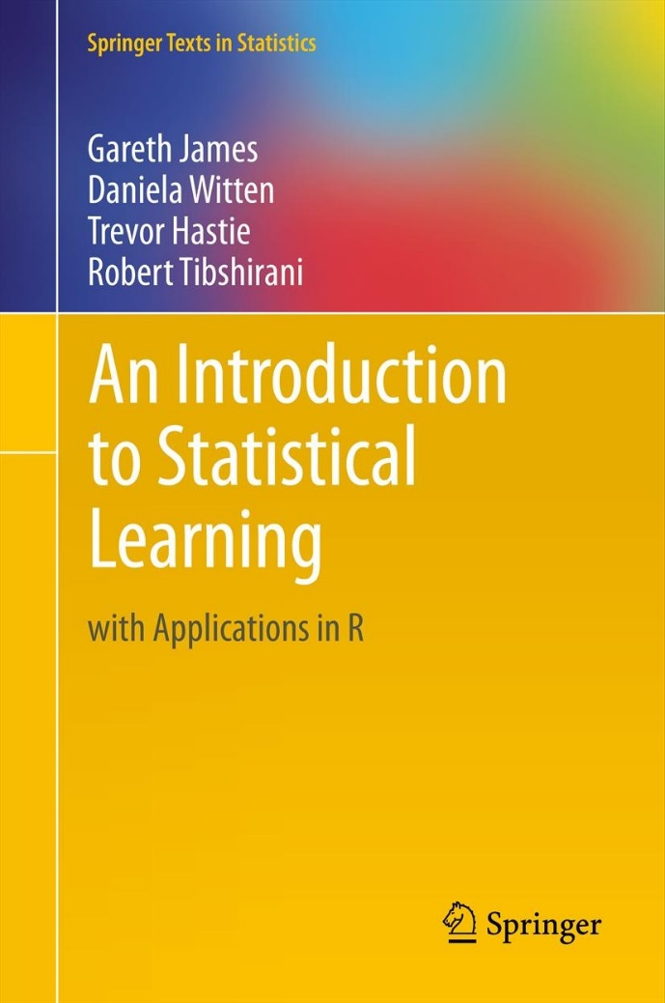
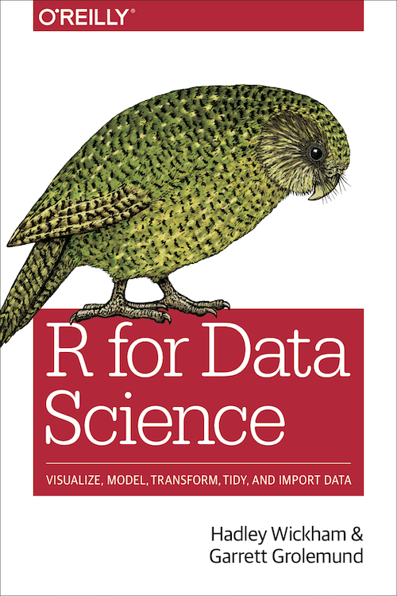
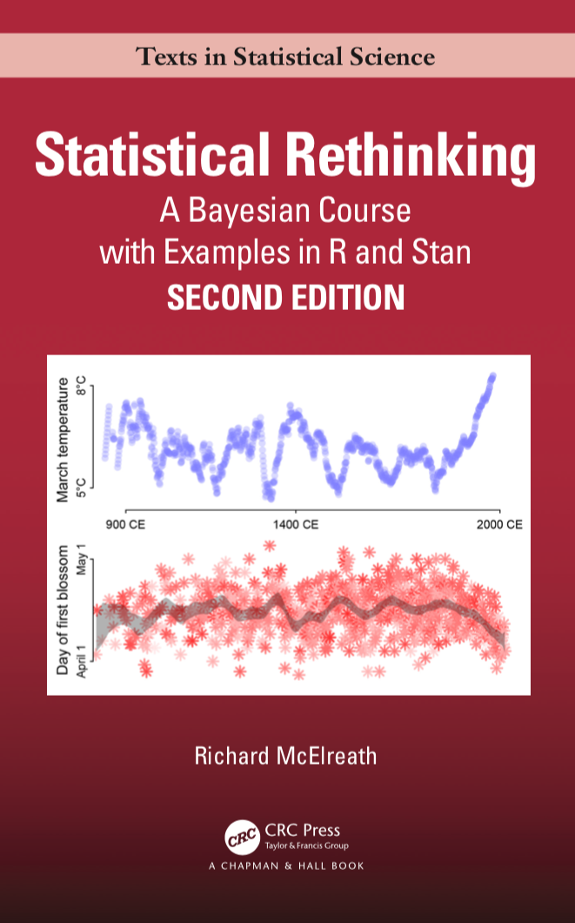
Additional texts

Slide 10
Evaluation Procedures
Research project (55%)
Topic idea (1%)
Project description (4%)
Data exploration report (10%)
Presentation (20%)
Project report (20%)
Mid-term exam (20%)
Participation in discussion (5%)
Computer lab exercises (20%)

Slide 11
Content of Project (Zuur et al. 2007 page viii)
Problem Statement:
These are my questions: …
This is my statistical approach: …
Presentation & Report:
Here is the method(s) that I employed…
Here’s proof that I did it all correctly (model validation): …
This is what the data show: …
Here is the ecological interpretation: …

Slide 12
Mid-Term Exam
Take home examination on statistical concepts and ‘literacy’
Covering lecture and lab topics through Feb 28 (Principal Component Analysis)

Slide 13
Class/Lab Schedule
Lectures: Tuesday/Thursday 10:30-11:30
R Labs: Wednesday 10:30-12:00
Student hours:
GF: (Zoom via Office Bookings)
Recordings via Zoom

Slide 14
Course Materials
Distributed via course website
gavinfay.github.io/mar536-biolstats2-s23
Class GoogleDoc for shared notes, sharing links, resources, tips, etc.
myCourses
Assignment submission

Slide 15
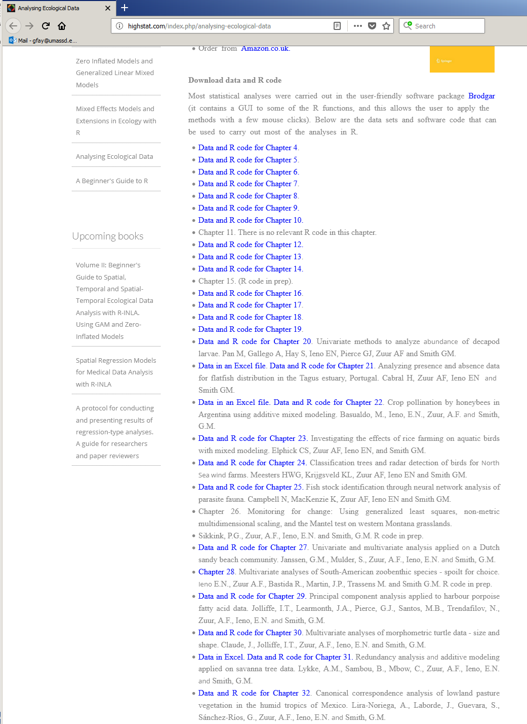
www.highstat.com/book1.htm

Slide 16
Data Management & Software
Statistical software:
Choice of software is largely unimportant
… but they may have different default settings or algorithms and give results.
You can use whatever software you choose for this class (DIY technical support).
However, because we need to teach SOMETHING, we will use R.
Your data are priceless:
Expensive to collect
Loss or corruption of data can be a disaster
Statistics courses have traditionally focused on experimental design, representative sampling and analytical approaches.
Workflow & data management, recording, entry, audit, storage and ‘collation’ have been relegated.

Slide 17
Database Design
Spreadsheets are convenient for small data sets but are inefficient and problematic for larger, more complicated databases (e.g., loss of data, lack of repeatability).
Relational databases (SQL) support:
Consistent, quick and accurate data entry
Quality control (valid range, cross-checking)
Efficient, secure data storage (relational, linked, indexed, backups)
Supports repeatable, complex data queries
Documented ‘metadata’ (table descriptions, variable definitions, code keys)

Slide 18
Reproducibility of Workflow
There should be a clear, transparent, repeatable path from your data, your analyses of those data, and your results and interpretation.
Trevor Branch rule:
“Every analysis you do on a dataset will have to be redone 10–15 times before publication. Plan accordingly.”

Slide 19
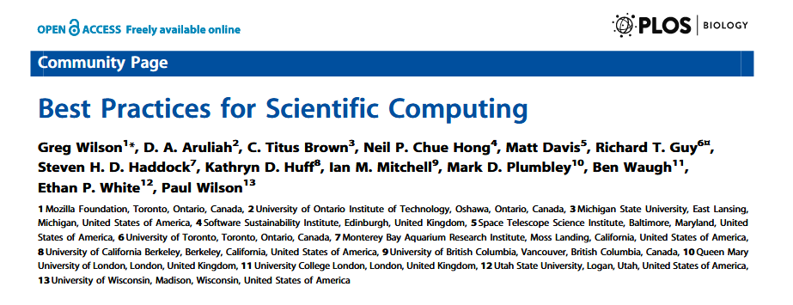
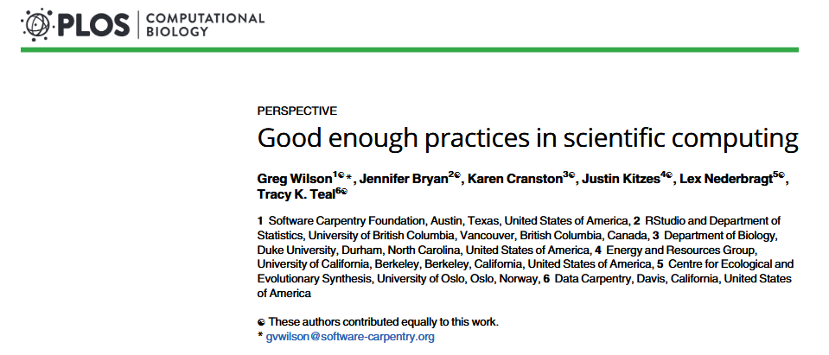
Best Good Enough practices
Wilson G, Aruliah DA, Brown CT, Chue Hong NP, Davis M, et al. (2014) Best Practices for Scientific Computing. PLoS Biol 12(1): e1001745. doi:10.1371/journal.pbio.1001745
Wilson G, Bryan J, Cranston K, Kitzes J, Nederbragt L, Teal TK (2017) Good enough practices in scientific Computing. PLoS Comput Biol 13(6): e1005510. https://doi.org/10.1371/journal.pcbi.1005510

Slide 20
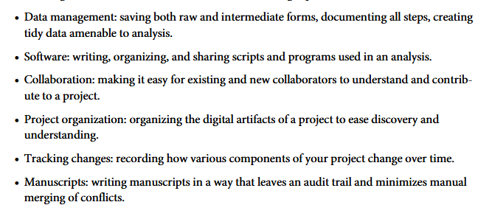
Best Good Enough practices
Wilson G, Bryan J, Cranston K, Kitzes J, Nederbragt L, Teal TK (2017) Good enough practices in scientific Computing. PLoS Comput Biol 13(6): e1005510. https://doi.org/10.1371/journal.pcbi.1005510

Slide 21
“If you don’t understand how the golem processes information, then you can’t interpret the golem’s output”
(McElreath 2020, Chap 1.2)

Slide 22
McElreath 2020, Fig 1.1

Slide 23
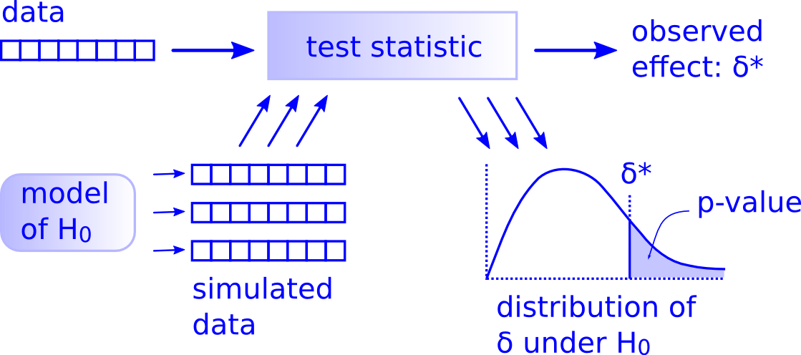
“There is only one test”
All statistical tests ask the same question:
"Is the apparent effect real, or is it due to chance?"
Differences lie in the assumptions & simplifying approximations to compute p-values efficiently.
http://allendowney.blogspot.com/2011/05/there-is-only-one-test.html

Slide 24
Statistical Rethinking
Going beyond ‘significant’ effects & recipes, develop statistical literacy
Specify hypotheses for explanations of data- construct models to test these.
Evaluate support in data for these models
Compare strength of evidence for alternative models
Make predictions based on statistical inference
Compute uncertainty associated with inference and predictions

Slide 25
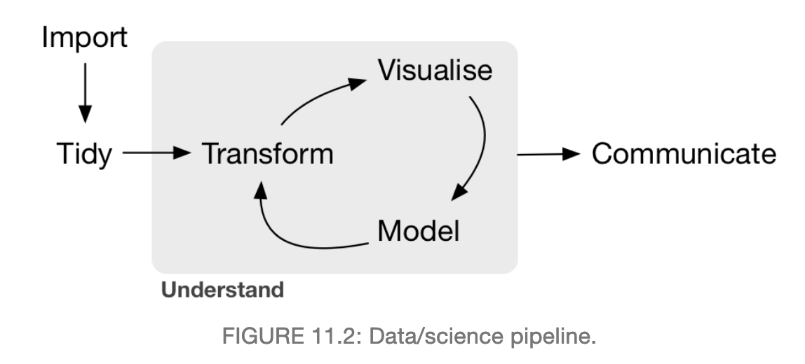
General approach for this class
Ismay & Kim 2019

Slide 26
Group exercise
non-profit in Sweden that promotes sustainable global development and achievement of UN Millennium Development Goals by increased use & understanding of statistics about social, economic and environmental development.
Hans Rosling (check out yt videos)
gapminder.org

Slide 27
Group exercise
‘gapminder.xlsx’ summarizes data on life expectancy & GDP for 142 countries.
What are some questions you might ask about these data?
What are some inferences you might want to make?
What might you want to compare? How might you visualize? What assumptions might you need to make?
gapminder.org

Slide 28
Schedule
Coming next….
Wednesday Lab – Introduction to R & R Studio
Thursday Lecture – Probability Review

Slide 29
Overview of Bivariate Methods
Transformation
- response variable?
explanatory variable?
- residuals?
Normality
- histograms
- Q-Q plots
Collinearity
-pairplots
PCA
coplots
Lattice plots
Data
Exploration
Outliers
- dotplots
- boxplots
Linear relationships
Nonlinear relationships
Linear
Regression
Additive
Modeling
Verify linearity or nonlinearlity
violation of
homogeneity
violation of
homogeneity
Generalized
Linear Modeling
Generalized
Additive Modeling

Slide 30
Overview of Multivariate Methods
Data
Exploration
not too
many zeros
Discriminant
Analysis
linear
relationships
known
group
membership
Principal
Component
Analysis
unimodal
explanatory
variables
Canonical
Correspondence
Analysis
Correspondence
Analysis
Redundancy
Analysis
unimodal
lots of
zeros
correlated variables
R-Technique
Principle Coordinate Analysis
Nonmetric Multidimensional Scaling
correlated observations
explanatory
variables
Q-Technique
- Mantel test
- Analysis of Similarities

